Slide 1
CSE 477: Introduction to Computer Security
Lecture – 8
Course Teacher: Dr. Md Sadek Ferdous
Assistant Professor, CSE, SUST
E-mail: ripul.bd@gmail.com

Slide 2
Outline
Number theory review
RSA Cryptosystem
RSA Implementation

Slide 3
Prime numbers
Prime number $p$:
$p$ is an integer (Integers are like whole numbers, but they also include negative numbers, but no fractions allowed)
$p≥2$
The only divisors of $p$ is 1 and $p$
Examples
2, 7, 19 are primes
-3, 0, 1, 6 are not primes
Prime decomposition (aka factorization) of a positive integer $n$:
$n=p_{1}^{e_{1}}×$ $p_{2}^{e_{2}}×… × p_{k}^{e_{k}}$
Example:
$200=2^{3}×5^{2}$
Fundamental Theorem of Arithmetic:
The prime decomposition of a positive integer is unique

Slide 4
Greatest Common Divisor (GCD)
The greatest common divisor (GCD) of two integers a and b, denoted gcd(a, b), is the largest positive integer that divides both a and b
Examples:
gcd(18, 30) = 6
gcd(0, 20) = 20
gcd(-21, 49) = 7
Two integers a and b are said to be relatively prime if gcd(a, b) = 1
Example:
15 and 28 are relatively prime, as gcd(15,28) = 1

Slide 5
Modular arithmetic
Modulo operator for a positive integer $n:$
$r=a mod n$, here, $r$ and $a$ are integers and $r$ is the reminder
It is equivalent to: $a=r+kn$
Here, $k$ is the quotient, also denoted with $q$
Example:
29 mod 13 = 3 13 mod 13 = 0 -1 mod 13 = 12
29 = 3 + 2 x 13 13 = 0 + 1 x 13 -1 = 12 + (-1) x 13
Modulo and GCD
gcd(a, b) = gcd(b, a mod b)
Example:
gcd(21, 12) = 3 gcd(12, 21 mod 12) = gcd(12, 9) = 3

Slide 6
Euclid’s GCD algorithm
Euclid’s algorithm for computing the GCD repeatedly applies the formula
gcd(a, b) = gcd(b, a mod b)
Example: gcd(412, 260) = 4
Algorithm EuclidGCD(a,b)
Input integers a and b
Output gcd(a,b)
if b = 0
return a
else
return EuclidGCD(b, a mod b)
a | 412 | 260 | 152 | 108 | 44 | 20 | 4
b | 260 | 152 | 108 | 44 | 20 | 4 | 0

Slide 7
Multiplicative Inverse
The residues modulo a positive integer $n$ are the set
$Z_{n}=\left\{0, 1, 2, …, \left(n−1\right)\right\}$
Let $x$ and $y$ be two elements of $Z_{n}$ such that: $xy mod n=1$
Then we say that $y$ is the multiplicative inverse of $x$ in $Z_{n}$
and we write $y=x^{−1} mod n$
Example:
Multiplicative inverses of the residues modulo 11
x | 0 | 1 | 2 | 3 | 4 | 5 | 6 | 7 | 8 | 9 | 10
x⁻¹ |  | 1 | 6 | 4 | 3 | 9 | 2 | 8 | 7 | 5 | 10

Slide 8
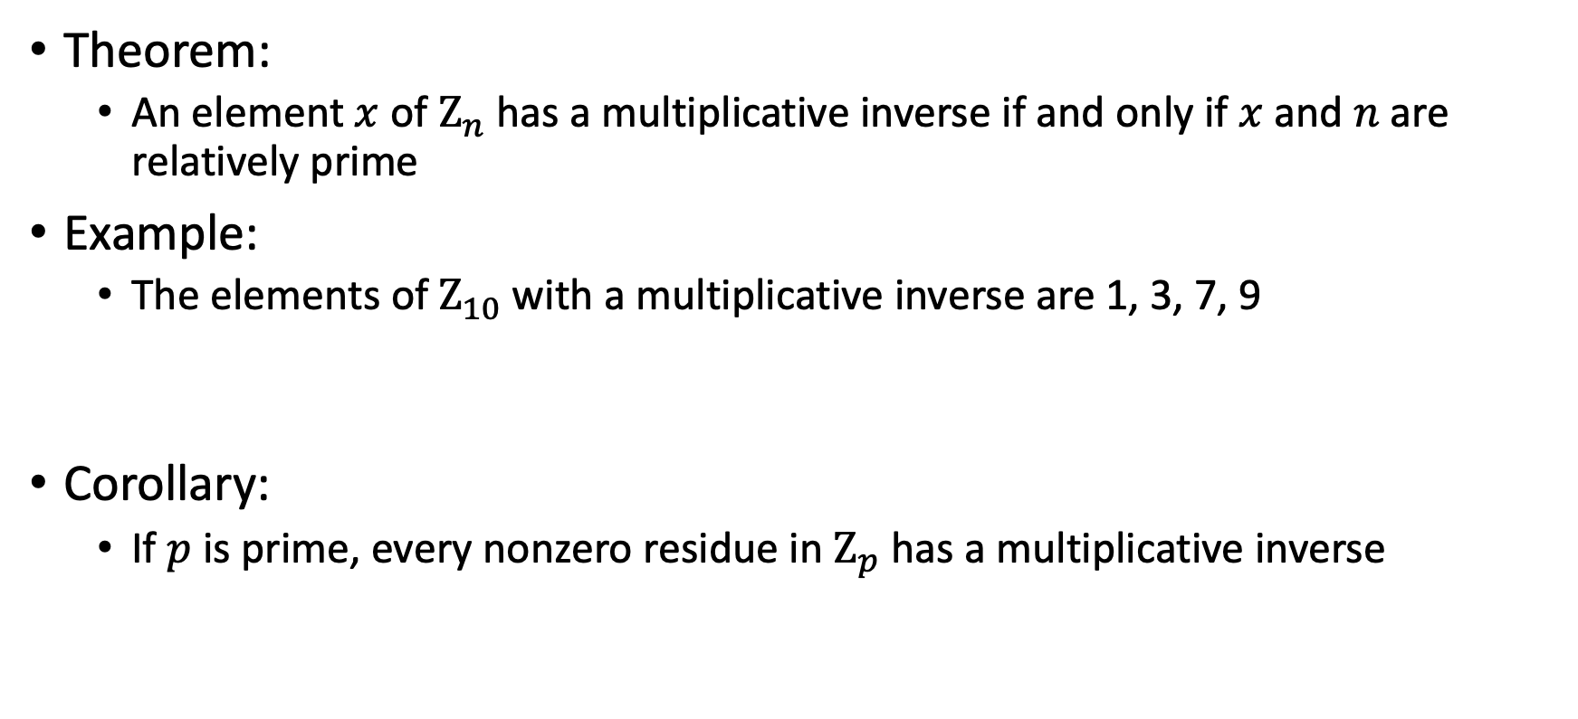
Multiplicative Inverse
Theorem:
An element $x$ of $Z_{n}$ has a multiplicative inverse if and only if $x$ and $n$are relatively prime
Example:
The elements of $Z_{10}$ with a multiplicative inverse are 1, 3, 7, 9
Corollary:
If $p$ is prime, every nonzero residue in $Z_{p}$ has a multiplicative inverse
x | 0 | 1 | 2 | 3 | 4 | 5 | 6 | 7 | 8 | 9
x⁻¹ |  | 1 |  | 7 |  |  |  | 3 |  | 9
x | 0 | 1 | 2 | 3 | 4 | 5 | 6 | 7 | 8 | 9 | 10
x⁻¹ |  | 1 | 6 | 4 | 3 | 9 | 2 | 8 | 7 | 5 | 10

Slide 9
Modular exponentiation
The form $x^{y} mod n$ is called the modular exponentiation
It has several properties
If $n$ is not prime, e.g. $n=10$, there are modular powers equal to 1 only for the elements of $Z_{n}$ that are relatively prime with $n$
That is, those elements whose gcd with $n$ is 1
For $n=10$, these elements are 1, 3, 7, 9
If $n$ is prime, e.g. $n=13$, every nonzero element of $Z_{n}$ has a power equal to 1

Slide 10
Fermat’s Little Theorem
Theorem
Let $p$ be a prime. For each nonzero residue $x$ of $Z_{p}$, we have
$x^{p−1} mod p=1$
Example ($p=5$):
$1^{4} mod 5=1$ $2^{4} mod 5=16 mod 5=1$
$3^{4} mod 5=81 mod 5=1$ $4^{4} mod 5=256 mod 5=1$
Corollary
Let $p$ be a prime. For each nonzero residue $x$ of $Z_{p}$, the multiplicative inverse of $x$ is $x^{p−2} mod p$
Proof
$x\left(x^{p−2}\right) mod p=x^{p−1} mod p=1$

Slide 11
Euler’s Theorem
The multiplicative group of $Z_{n}$, denoted with $Z_{n}^{∗}$, is the subset of elements of $Z_{n}$relatively prime with $n$
The totient function of $n$, denoted with $Φ\left(n\right)$ is the size of $Z_{n}^{∗}$, $Φ\left(n\right)=|Z_{n}^{∗}|$
Example :
$Z_{10}^{∗}=\{1,3,7,9\}$ $Φ\left(10\right)=4$
If $p$ is prime, we have:
$Z_{p}^{∗}=\{1,2,3,…,(p−1)\}$ $Φ\left(p\right)=p−1$
Theorem:
For each element $x$ of $Z_{n}^{∗}$ we have: $x^{Φ\left(n\right)} mod n=1$
Example ($n=10)$
$3^{Φ\left(10\right)} mod 10=3^{4} mod 10=81 mod 10=1$
$7^{Φ\left(10\right)} mod 10=7^{4} mod 10=2401 mod 10=1$
$9^{Φ\left(10\right)} mod 10=9^{4} mod 10=6561 mod 10=1$

Slide 12
RSA Cryptosystem
RSA is named after its inventors, Ronald Rivest, Adi Shamir, and Leonard Adleman
First published in 1977
It is based on the practical difficulty of the factorization of the product of two large prime numbers
One of the most widely used cryptosystems
Because of its implications, the inventors have received Turing prize in 2002, the so-called Noble prize of CS

Slide 13
RSA Cryptosystem
Setup
$n=pq$, here $p$ and $q$ should be large prime numbers (e.g. 1024 digits)
$e$ is chosen such that it is relatively prime to $Φ\left(n\right)$
That is $gcd\left(e,Φ\left(n\right)\right)=1$
$Φ\left(n\right)=Φ\left(p\right)Φ\left(q\right)=\left(p−1\right)\left(q−1\right)$
$d$ is inverse of $e$ in $Z_{Φ\left(n\right)}$
That is $de mod Φ\left(n\right)=1$
Keys
Public key, $K_{e}=(n,e)$
Private key, $K_{d}=d$
Encryption
Plaintext , $M$
Ciphertext, $C=M^{e} mod n$
Decryption
$M=C^{d} mod n$
Setup
$p=7$, $q=17$
$n=7×17=119$
$Φ\left(n\right)=\left(p−1\right)\left(q−1\right)=6×16=96$
$e=5$
$d=77$
Keys
Public key: $(119,5)$
Private key: $77$
Encryption
$M=19$
$C={19}^{5} mod 119=66$
Decryption
$M={66}^{77} mod 119=19$

Slide 14
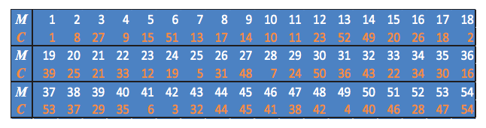
RSA Cryptosystem
Setup
$p=5$, $q=11$
$n=5×11=55$
$Φ\left(n\right)=4×10=40$
$e=3$
$d=27 (3.27=81=2.40+1)$
Encryption
$C=M^{3} mod 55$
Decryption
$M=C^{27} mod 55$

Slide 15
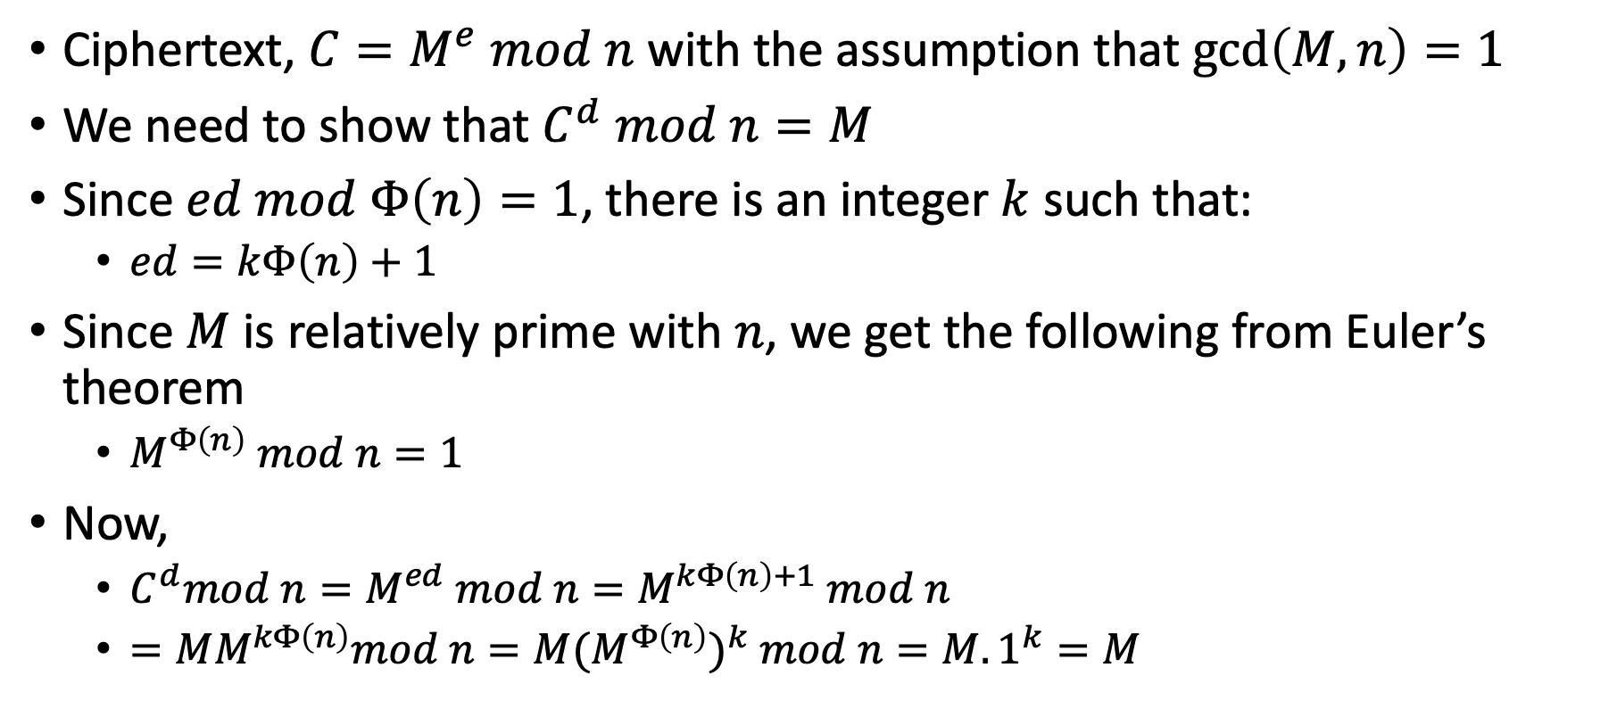
RSA Correctness
Ciphertext, $C=M^{e} mod n$ with the assumption that $gcd\left(M,n\right)=1$
We need to show that $C^{d} mod n=M$
Since $ed mod Φ\left(n\right)=1$, there is an integer $k$ such that:
$ed=kΦ\left(n\right)+1$
Since $M$ is relatively prime with $n$, we get the following from Euler’s theorem
$M^{Φ\left(n\right)} mod n=1$
Now,
$C^{d}mod n=M^{ed} mod n=M^{kΦ\left(n\right)+1} mod n$
$=MM^{kΦ\left(n\right)}mod n={M{(M}^{Φ\left(n\right)})}^{k} mod n=M.1^{k}=M$

Slide 16
RSA Security
The security of the RSA cryptosystem is based on the difficulty of finding d, given e and n
If we knew φ(n) = (p−1)(q−1), it would be easy to compute d from e
Thus, Bob needs to keep p and q secret (or even destroy all knowledge of them), since anyone who knows the values of p and q immediately knows the value of φ(n)
Anyone who knows the value of φ(n) can compute d = e⁻¹ mod φ(n), using the extended Euclidian algorithm
Thus, the security of the RSA cryptosystem is closely tied to factoring n, which would reveal the values of p and q
Fortunately, since this problem has shown itself to be hard to solve, we can continue to rely on the security of the RSA cryptosystem, provided we use a large enough modulus

Slide 17
RSA Security
In 1999, 512-bit challenge factored in 4 months using 35.7 CPU-years
160 175-400 MHz SGI and Sun
8 250 MHz SGI Origin
120 300-450 MHz Pentium II
4 500 MHz Digital/Compaq
In 2005, a team of researchers factored the RSA-640 challenge number using 30 2.2GHz CPU years
In 2004, the prize for factoring RSA-2048 was $200,000
Current practice is 2,048-bit keys
Estimated resources needed to factor a number within one year
Length (bits) | PCs | Memory
430 | 1 | 128MB
760 | 215,000 | 4GB
1020 | 342x10⁶ | 170GB
1620 | 1.6x10¹⁵ | 120TB

Slide 18
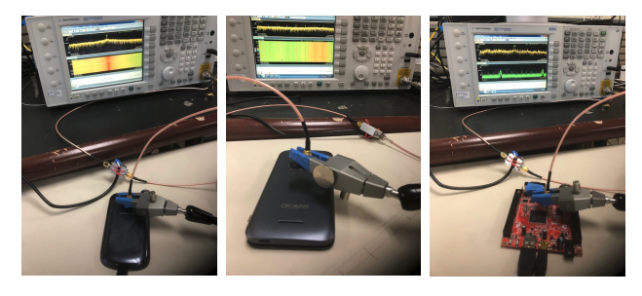
RSA Security
Side channel attacks have also been demonstrated on RSA, based on measuring the time taken by decryption and/or the power consumption of the CPU performing the operation
A very recent (30 August, 2018) research presented at USENIX’18, authors were able to retrieve the encryption keys from mobile device within seconds and without physical access to the devices
The attack recovers the exponent’s bits during modular exponentiation from analog signals that are unintentionally produced by the processor
https://www.usenix.org/system/files/conference/usenixsecurity18/sec18-alam.pdf

Slide 19
RSA Determinism
We must take some care in how we use the RSA cryptosystem, however, because of its deterministic nature
For example, suppose we use the RSA algorithm to encrypt two plaintext messages, M₁ and M₂, into the respective ciphertexts, C₁ and C₂, using the same public key
Because RSA is deterministic, we know that, in this case, if C₁ = C₂, then M₁ = M₂
Unfortunately, this fact could allow a cryptanalyst to infer information from ciphertexts encrypted from supposedly different plaintexts
There is an alternative cryptosystem which can handle this issue

Slide 20
RSA Implementation
The implementation of the RSA cryptosystem requires various algorithms
Overall
Representation of integers of arbitrarily large size and arithmetic operations on them
Encryption
Modular power
Decryption
Modular power
Setup
Generation of random numbers with a given number of bits (to generate candidates p and q)
Primality testing (to check that candidates p and q are prime)
Computation of the GCD (to verify that e and $Φ\left(n\right)$ are relatively prime)
Computation of the multiplicative inverse (to compute d from e)

Slide 21
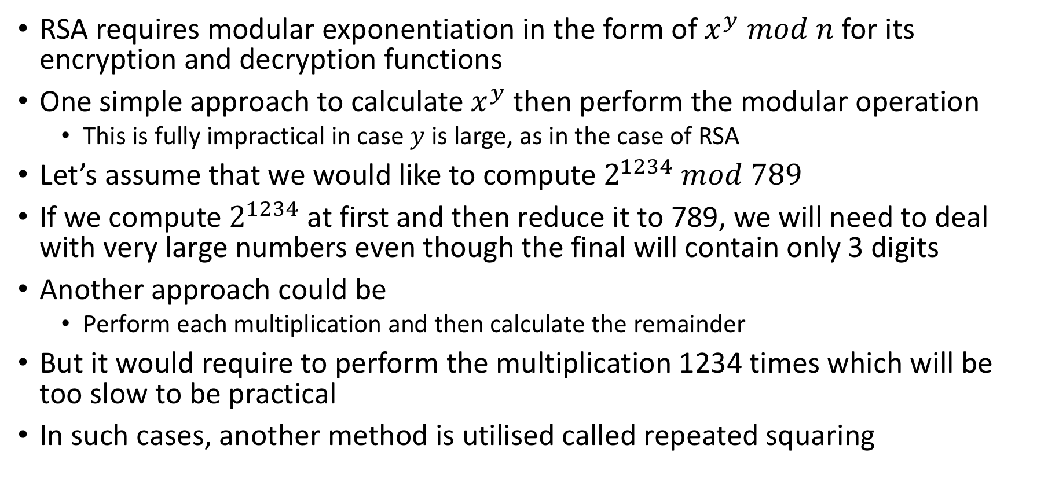
Repeated squaring
RSA requires modular exponentiation in the form of $x^{y} mod n$ for its encryption and decryption functions
One simple approach to calculate $x^{y}$then perform the modular operation
This is fully impractical in case $y$is large, as in the case of RSA
Let’s assume that we would like to compute $2^{1234} mod 789$
If we compute $2^{1234}$ at first and then reduce it to 789, we will need to deal with very large numbers even though the final will contain only 3 digits
Another approach could be
Perform each multiplication and then calculate the remainder
But it would require to perform the multiplication 1234 times which will be too slow to be practical
In such cases, another method is utilised called repeated squaring

Slide 22
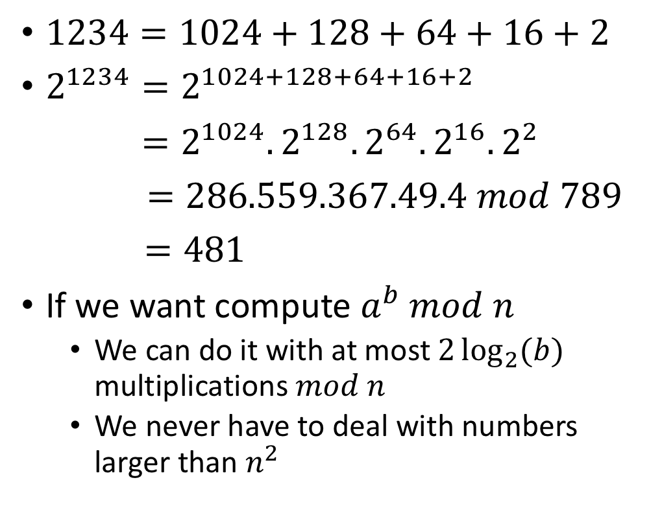
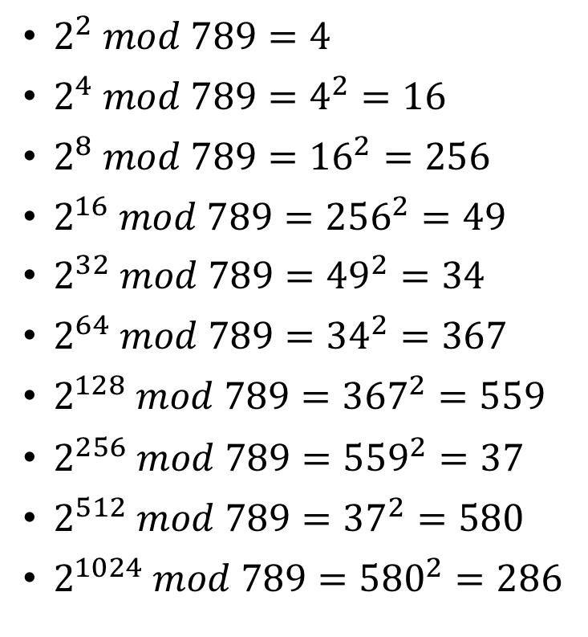
Repeated squaring
$2^{2} mod 789=4$
$2^{4} mod 789=4^{2}=16$
$2^{8} mod 789={16}^{2}=256$
$2^{16} mod 789={256}^{2}=49$
$2^{32} mod 789={49}^{2}=34$
$2^{64} mod 789={34}^{2}=367$
$2^{128} mod 789={367}^{2}=559$
$2^{256} mod 789={559}^{2}=37$
$2^{512} mod 789={37}^{2}=580$
$2^{1024} mod 789={580}^{2}=286$
$1234=1024+128+64+16+2$
$2^{1234}=2^{1024+128+64+16+2}$
$=2^{1024}. 2^{128}. 2^{64}.2^{16}.2^{2}$
$=286.559.367.49.4 mod 789$
$=481$
If we want compute $a^{b} mod n$
We can do it with at most $2\log_{2}{(b)}$ multiplications $mod n$
We never have to deal with numbers larger than $n^{2}$

Slide 23
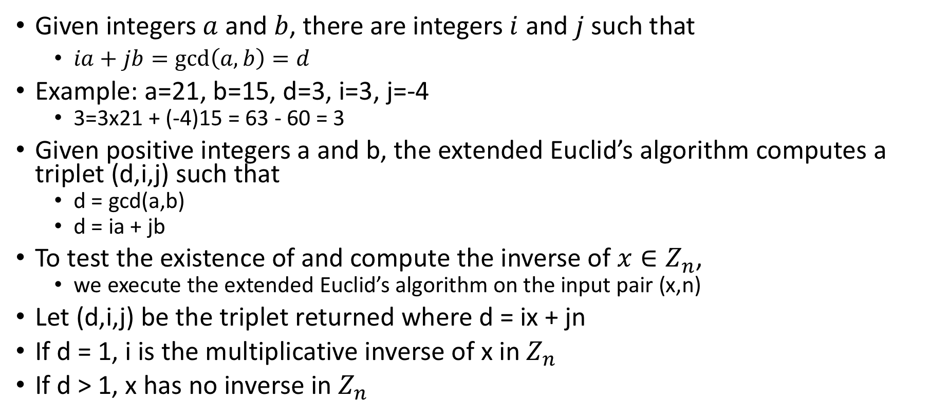
Multiplicative inverse calculation
Given integers $a$ and $b$, there are integers $i$ and $j$ such that
$ia+jb=\gcd\left(a,b\right)=d$
Example: a=21, b=15, d=3, i=3, j=-4
3=3x21 + (-4)15 = 63 - 60 = 3
Given positive integers a and b, the extended Euclid’s algorithm computes a triplet (d,i,j) such that
d = gcd(a,b)
d = ia + jb
To test the existence of and compute the inverse of $x∈Z_{n}$,
we execute the extended Euclid’s algorithm on the input pair (x,n)
Let (d,i,j) be the triplet returned where d = ix + jn
If d = 1, i is the multiplicative inverse of x in $Z_{n}$
If d > 1, x has no inverse in $Z_{n}$

Slide 24
Primality testing
Yet another important computation that is often used in modern cryptography is primality testing
In this instance, we are given a positive integer, n, and we want to determine if n is prime or not
Fortunately, there are efficient methods for performing such tests
None of these methods actually factor n
They just indicate whether n is prime or not

Slide 25
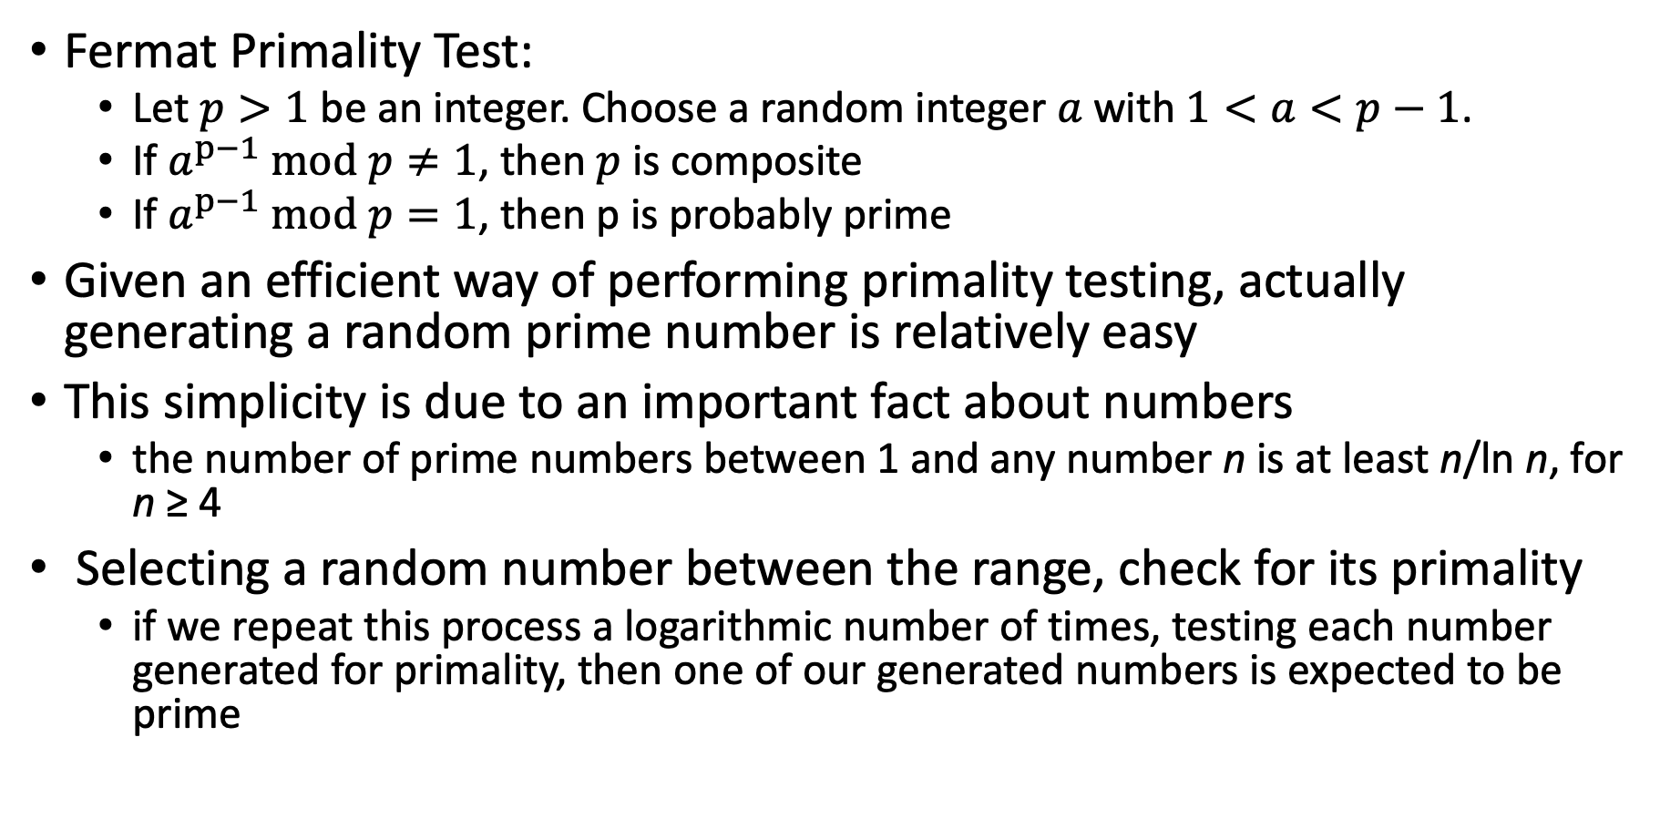
Primality testing
Fermat Primality Test:
Let $p>1$ be an integer. Choose a random integer $a$ with $1<a<p−1$.
If $a^{p−1} mod p≠1$, then $p$ is composite
If $a^{p−1} mod p=1$, then p is probably prime
Given an efficient way of performing primality testing, actually generating a random prime number is relatively easy
This simplicity is due to an important fact about numbers
the number of prime numbers between 1 and any number n is at least n/ln n, for n ≥ 4
Selecting a random number between the range, check for its primality
if we repeat this process a logarithmic number of times, testing each number generated for primality, then one of our generated numbers is expected to be prime

Slide 26
Typical RSA use-case
Even with an efficient implementation, the RSA cryptosystem is orders-of-magnitude slower than the AES symmetric cryptosystem
Thus, a standard approach to encryption is as follows:
Encrypt a secret key, K, with the RSA cryptosystem for the AES symmetric cryptosystem
Encrypt with AES using key K
Transmit the RSA-encrypted key together with the AES-encrypted document
The above method illustrates a common use of public-key cryptography in conjunction with a symmetric cryptosystem

Slide 28
